Slide 1
SQL FOREIGN KEY Constraint
A FOREIGN KEY is a key used to link two tables together.
A FOREIGN KEY is a field (or collection of fields) in one table that refers to the PRIMARY KEY in another table.
The table containing the foreign key is called the child table, and the table containing the candidate key is called the referenced or parent table.
CREATE TABLE `address` ( `ADDRESS_ID` int unsigned NOT NULL AUTO_INCREMENT, `EMPLOYEE_ID` int unsigned NOT NULL, `STREET_NAME` varchar(100) NOT NULL, `CITY` varchar(100) NOT NULL, `COUNTRY` varchar(100) NOT NULL, `ZIPCODE` varchar(100) NOT NULL, `CREATED_DATE` date DEFAULT NULL, PRIMARY KEY (`ADDRESS_ID`), KEY `EMPLOYEE_ADDRESS_LINK` (`EMPLOYEE_ID`), CONSTRAINT `EMPLOYEE_ADDRESS_LINK` FOREIGN KEY (`EMPLOYEE_ID`) REFERENCES `employee` (`EMPLOYEE_ID`) ) ENGINE=InnoDB AUTO_INCREMENT=6 DEFAULT CHARSET=utf8
ALTER TABLE address
DROP FOREIGN KEY EMPLOYEE_ADDRESS_LINK;
ALTER TABLE address
ADD FOREIGN KEY (EMPLOYEE_ID) REFERENCES employee(EMPLOYEE_ID);

Slide 2
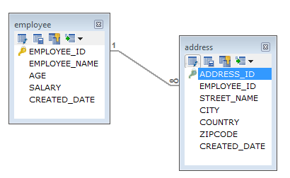
SQL FOREIGN KEY Constraint
In a one-to-many relationship, one record in a table can be associated with one or more records in another table.

Slide 3
SQL FOREIGN KEY Constraint
Employee
EMPLOYEE_ID | EMPLOYEE_NAME | AGE | SALARY | CREATED_DATE
1 | Peter | 32 | 7000 | 2019-09-03
2 | Dave | 34 | 8000 | 2019-09-04
3 | John | 45 | 10000 | 2019-09-24
Address
ADDRESS_ID | EMPLOYEE_ID | STREET_NAME | CITY | COUNTRY | ZIPCODE | CREATED_DATE
1 | 1 | 18,Dark Street | Chennai | India | 680009 | 2019-09-10
2 | 1 | 90,West Street | Bangalore | India | 655556 | 2019-09-18
3 | 2 | 898,East Street | Bangalore | India | 565565 | 2019-09-14
4 | 2 | 676,North Street | Chennai | India | 767676 | 2019-09-18
5 | 2 | 434,Good Street | Kerala | India | 656565 | 2019-09-16

